Slide 1
A Catholic introduction to artificial intelligence Class 1 lecture
Home School Connections
Instructor
Mr. Dan Goddu BSCS LSSBB CIAAI-JHU

Slide 2
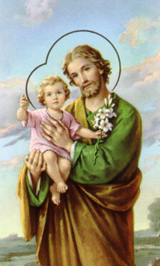
Opening Prayer
O Glorious St. Joseph, model of all those who are devoted to labor, obtain for me the grace to work conscientiously, putting the call of duty above my natural inclinations; to work with gratitude and joy, in a spirit of penance for the remission of my sins, considering it an honor to employ and develop by means of labor the gifts received from God; to work with order, peace, moderation, and patience, without ever shrinking from weariness and difficulties; to work above all with purity of intention and detachment from self, having always death before my eyes and the account that I must render of time lost, of talents wasted, of good omitted, of vain complacency in success, so fatal to the work of God. All for Jesus, all through Mary, all after thine example, O Patriarch, St. Joseph. Such shall be my motto in life and in death. Amen.

Slide 3

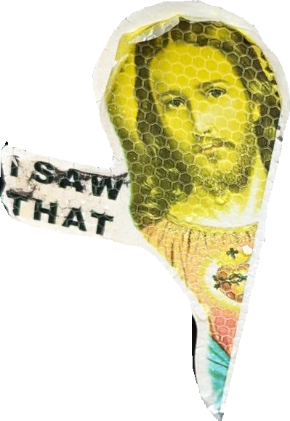
What you will learn in this class
Understand the course structure and expectations.
Define Artificial Intelligence (AI) in our own words.
Distinguish between AI, Machine Learning (ML), and Deep Learning (DL).
Identify examples of AI in your daily lives.
Begin to think critically about what AI is and what it is not.

Slide 4
Catholic Church view of Science
The Catholic Church views science to explore and comprehend the natural world created by God.
Technology is encouraged when it respects ethical principles and upholds the dignity of human life. Catholics recognize the benefits of technological advancements for improving human life and society.
Moral discernment is crucial to guide technology to serve humanity ethically and avoid harm or injustice.

Slide 5
Course objectives
Be critical thinkers and responsible users of Artificial Intelligence using the Catholic Church’s understanding of science
Understand how AI impacts privacy, ethics, employment, and truth.

Slide 6
Course requirements
Tools
Large Language Models
NotebookLM
Jupyter Notebook
Visual Studio Code or Google Colab or Jupyter Lite
Ollama
ChatGPT or Gemini or Claude

Slide 7
Course expectations
This is a live course - you are expected to attend the live session each week.
You are expected to complete all assignments on time. There is a 20% late penalty for late assignments. Any assignment not submitted within two weeks of its due date will not be accepted.
This course will use the following Academic Integrity Policy (AIP) as it relates to the use ofartificial intelligence. All other common-sense integity policies also remain in effect.

Slide 8
Academic Integrity Policy (AIP)

Slide 9
Assessment overview
Short essays - 30%
Quizzes- 10%
Labs - 20%
Final Project - 40%

Slide 10
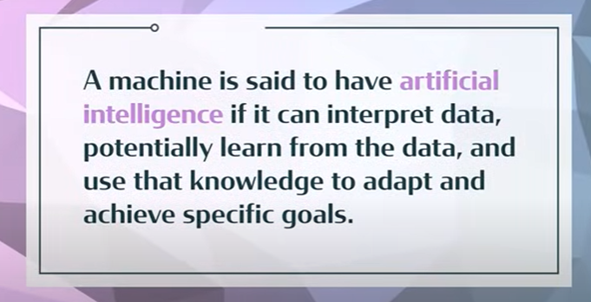
What is AI?
Artificial intelligence is an ever-expanding branch of computer science that focuses on making machines capable of performing tasks that usually require human intelligence, such as “reasoning”, solving problems, making decisions, “perceiving the world”, making meaning, and learning from experience.

Slide 11
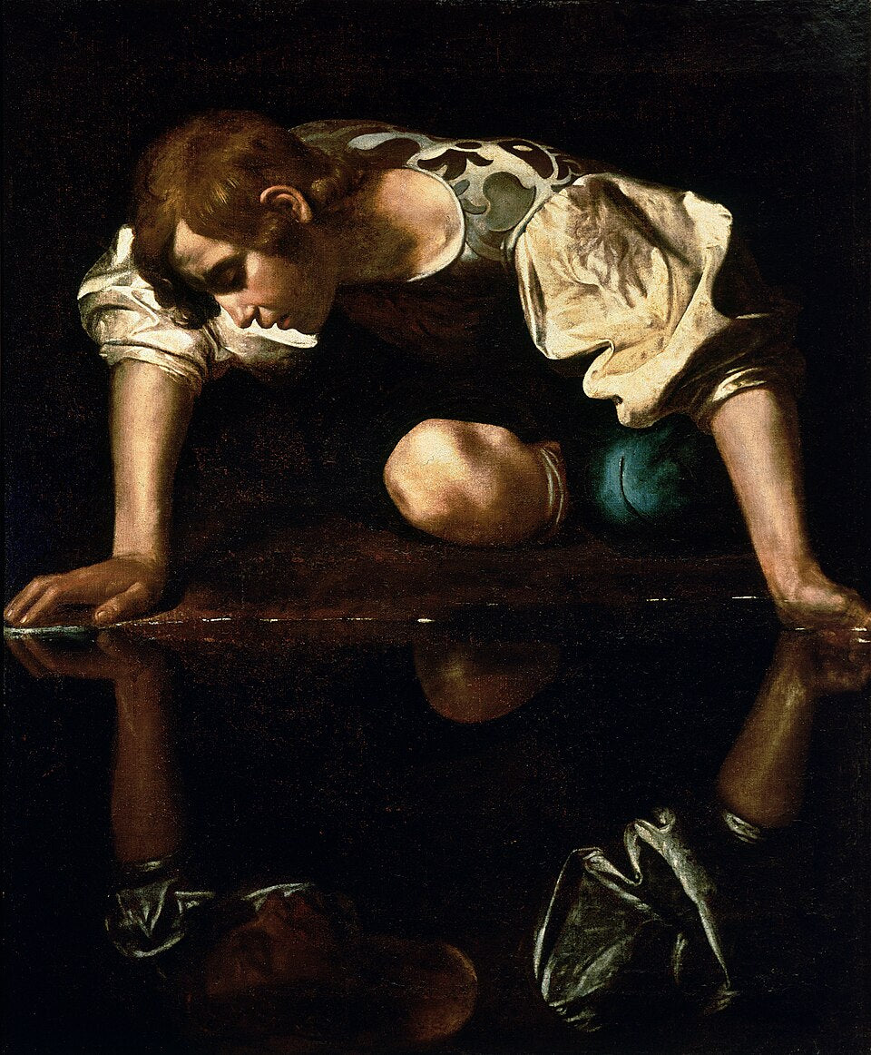
Self-Awareness
Self-awareness refers to the ability to have a clear and accurate understanding of your thoughts, feelings, values, strengths, weaknesses, motivations, and behaviors. It involves being able to observe yourself from outside, recognizing your patterns, habits, and emotions, and making conscious choices about how you want to present yourself to the world.

Slide 12
The Big Picture of AI
Predictive analytics (forecasting sales, risk, fraud)
Recommendation systems (Netflix, Amazon)
Computer vision (medical imaging, self-driving cars)
Robotics
Speech recognition
Search & ranking
Optimization systems
Generative

Slide 13
most AI in the world is
Fraud detection systems
Logistics optimization
Supply chain modeling
Ad targeting
Industrial automation
Risk scoring
Credit models
Manufacturing control systems

Slide 14
Types of ai by market share

Slide 15
Ai capabilities
Narrow AI that is good at one specific task (or a narrow set of tasks)
General AI can learn and perform any intellectual tasks a human can perform
Superintelligence AI

Slide 16
Differences between cs, ml, and dl
CS – Computer Science
ML – Machine Learning
DL – Deep Learning

Slide 17
Where Is AI Being Used Today?
https://www.youtube.com/watch?v=4ocBFGtukow
Notes:
Generative pre-trained transformer

Slide 18
It’s Been Around a Long Time
Netflix recommendations
Keyboard assistance
Grammar checkers
Face recognition
Voice recognition
Chat bots
GPS/Traffic/Maps
Email spam filters
Machine Learning
Transformers

Slide 19
Ethics and Bias Teasers
AI can make mistakes (e.g., false arrests due to facial recognition errors).
Data used to train AI can be biased.
Discussion: Should we always trust AI?
Discussion: Who is responsible when AI is wrong?

Slide 20
assignments

Slide 21
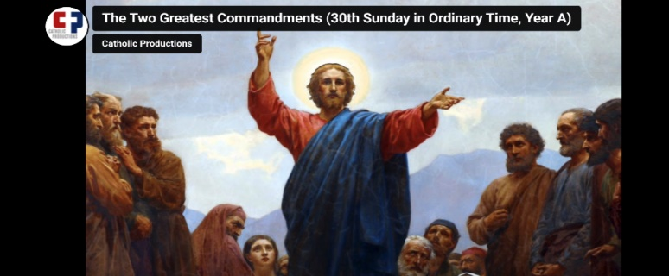
Closing Prayer

Slide 22
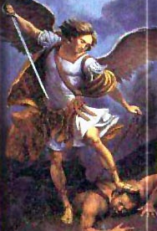
Prayer to St. Michael Archangel
St. Michael the Archangel, defend us in battle. Be our protection against the wickedness and snares of the Devil. May God rebuke him, we humbly pray. And do thou, O Prince of the heavenly hosts, by the power of God, cast into hell Satan, and all the evil spirits, who prowl about the world seeking the ruin of souls. Amen.

Slide 23
“AI” In Hollywood
War Games
https://www.youtube.com/watch?v=s93KC4AGKnY (1:34)
The Terminator
https://www.youtube.com/watch?v=4DQsG3TKQ0I
I Robot
https://www.youtube.com/watch?v=05bGPiyM4jg
Tesla robots
https://www.youtube.com/watch?v=cpraXaw7dyc
https://www.youtube.com/watch?v=ZTrebszENNw
https://www.youtube.com/watch?v=T6KtiOmRkn8 (1:02)

Slide 24
Resources
https://www.youtube.com/watch?v=8u4SeFnY9Jc&t=283s
https://www.youtube.com/watch?v=Wjrdr0NU4Sk

